Slide 1
Franka + Max

Slide 2
Outline
Open Project
Configure environment
Call Franka Service
Call Max Interface

Slide 3
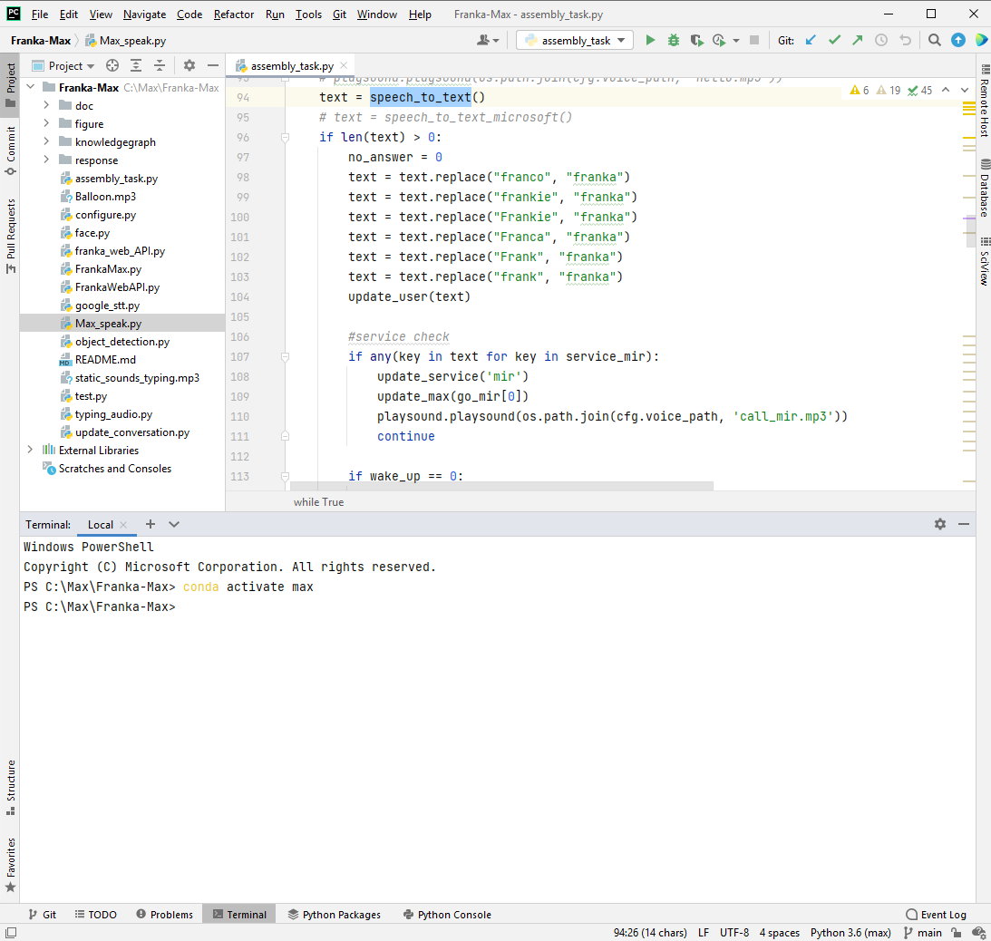
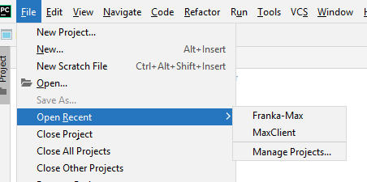
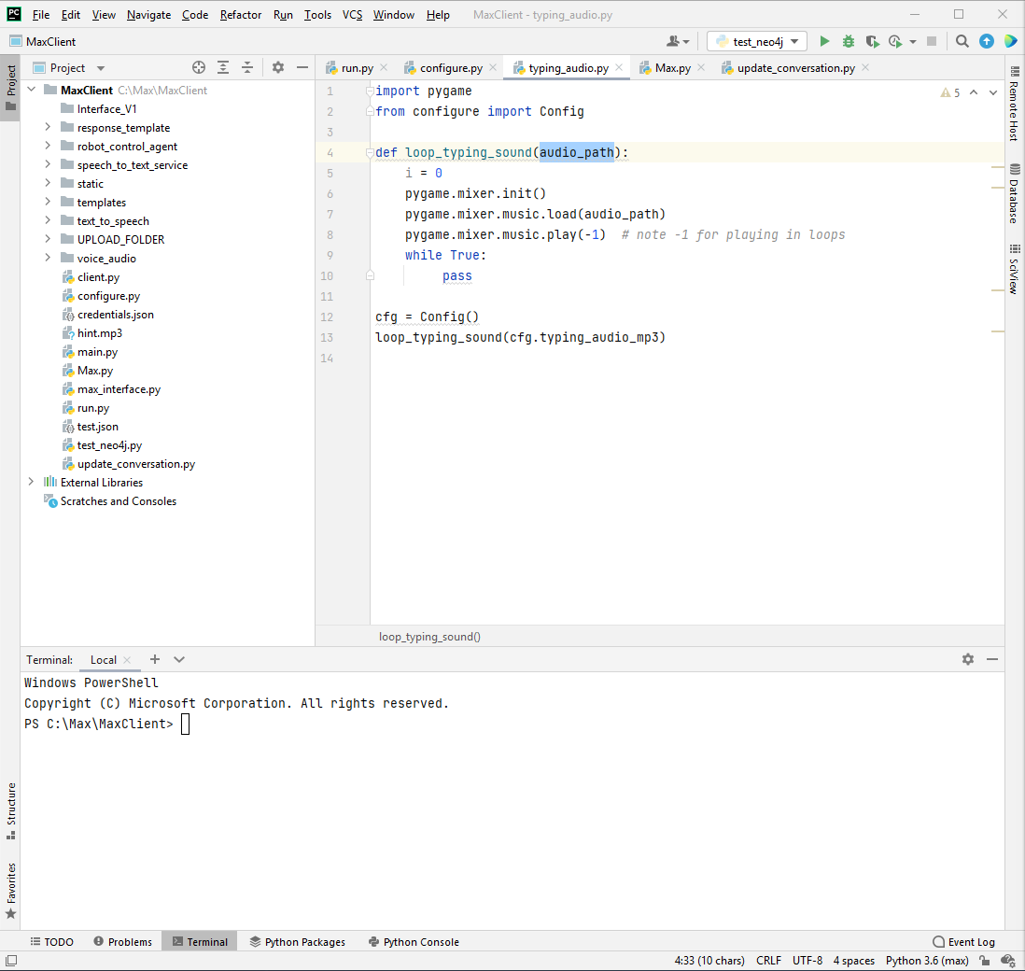

Open Project
Franka-Max
1. Open pycharm on your desktop
2. Open Franka-Max and MaxClient (you need to open both of them)
Max

Slide 4
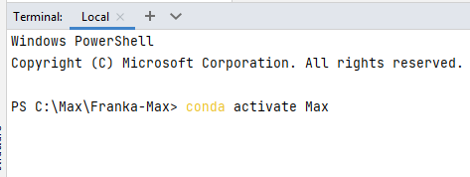
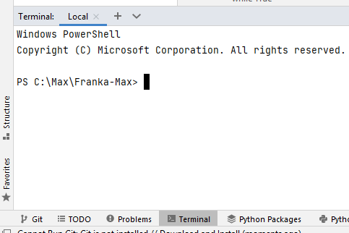
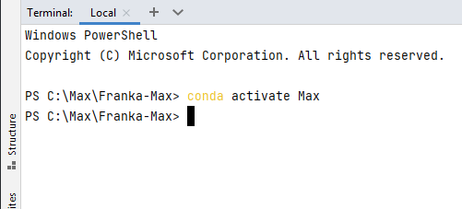
Configure Environment
2. Enter the command as show in the red box and press “Enter”
1. After you open the project, you will need to click the “Terminal” at the bottom part.
3. Then you are in the conda environment.
We use Franka-Max project as an example. You need to do the same for Max project as well.

Slide 5
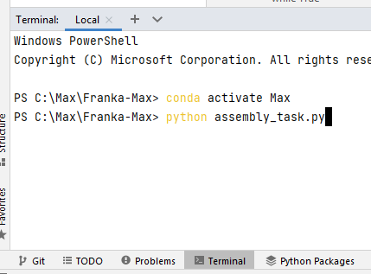
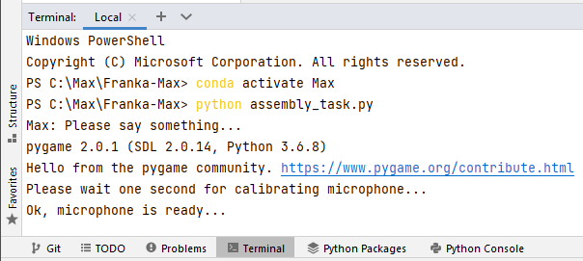
Call Franka Service
This is Franka project environment
1. After you enter the conda environment, you need to run this script (see the red box)
2. Then you will see the information like this. You may start to talk when you see “Ok, microphone is ready…” (see the red box)

Slide 6
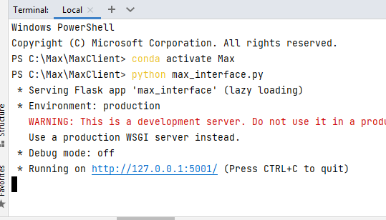
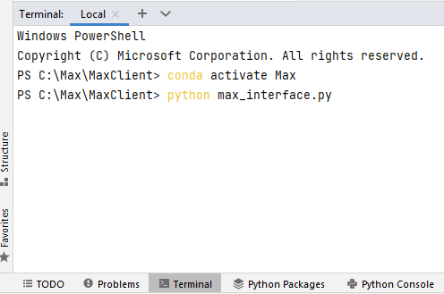
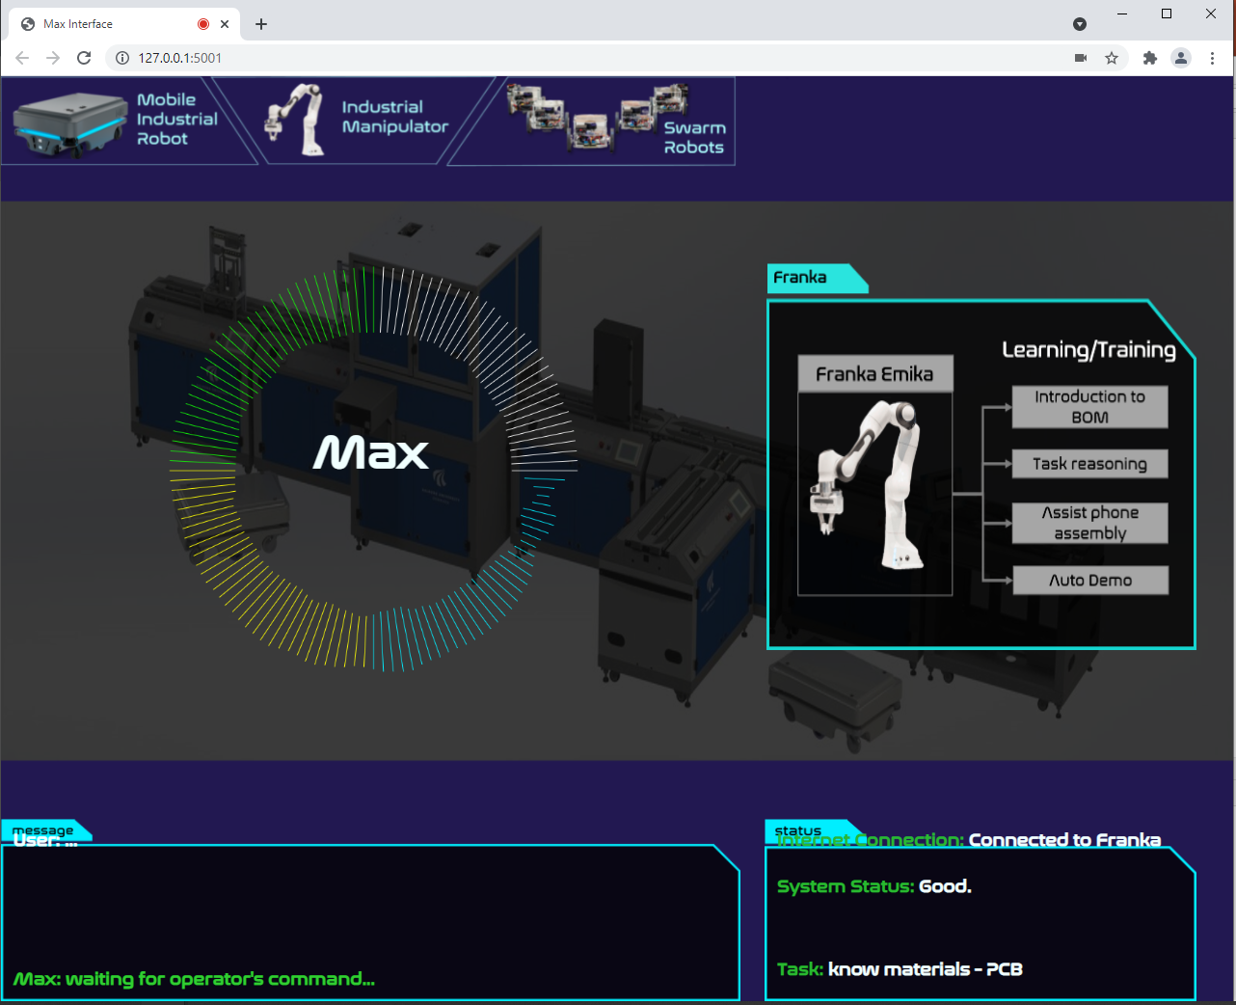
Call Max Interface
This is Max project environment
2. Then you will see the information like this. Click the url (see the red box), it will open web browser.
3. You will see something
like this in your web browser.
1. After you enter the conda environment, you need to run this script (see the red box)

Slide 7
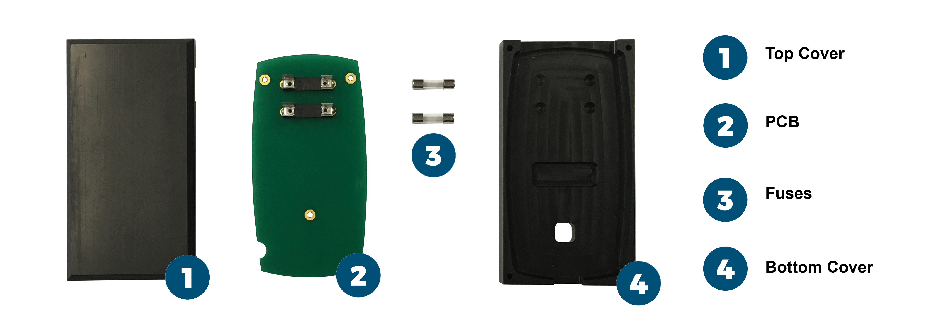
Services of Franka Robot
Tasks
Phone Assembly

Slide 8
Services of Franka Robot
What can Max do with Franka Robot?
Explain the terminology of the “Phone”
Reason relationship among phone assembly processes
Control Franka robot to grasp object
Control Franka robot to show a demonstration of phone assembly
Control Franka robot to guide user to assemble a phone

Slide 9
Question service info.
Terminology | Keywords | Example question
Check service | [‘service‘, ‘introduction’] | What kind of service can you provide?

Slide 10
Explain the Terminology
Terminology | Keywords | Example question
product | ['product'] | What kind of product are you producing?
lab | ['lab', 'learning factory'] | Can you tell me more about the lab?
process | ['process', 'processes'] | How many process we need to assemble a phone?
PCB | ['PCB', 'green'] | What is the green thing on the table?
fuse | [ 'fuse', ‘small thing‘ ] | What is the small thing on the table?
House/bottom cover | ['house', ‘bottom cover’, ‘hole’] | What is the house?
Top cover | [‘top cover‘, ‘blue’] | What is the top cover?

Slide 11
Reasoning the relationship among processes
process | Keywords | Example Question
PCB & fuse | ['PCB', 'green'] + [ 'fuse', ‘small thing‘ ] | Can I put the fuse on PCB?
PCB & Top Cover | ['PCB', 'green'] + [‘top cover‘, ‘blue’] | What is the relationship between PCB and top cover?
PCB & Bottom Cover | ['PCB', 'green'] + ['house', ‘bottom cover’, ‘hole’] | Does PCB match bottom cover?
fuse & Bottom Cover | [ 'fuse', ‘small thing‘ ] + ['house', ‘bottom cover’, ‘hole’] | How about fuse and bottom cover?
fuse & Top Cover | [ 'fuse', ‘small thing‘ ] + [‘top cover‘, ‘blue’] | Can we assemble fuse on top cover?
bottom & Top cover | ['house', ‘bottom cover’, ‘hole’] + [‘top cover‘, ‘blue’] | I guess top cover should be put on the bottom cover, right?

Slide 12
Grasp object
Action Keyword | ['back', 'bring', 'give', 'fetch', 'pass', 'need', 'play', 'grab', 'grasp']
+
object | Keywords | Example Question
Fuse one | ['a', 'one', '1']+ [ 'fuse', ‘small thing‘ ] | Can you bring a fuse to me?
Fuse two | ['another', 'second', 'other'] + ['fuse', ‘small thing‘ ] | Please grasp another fuse?
PCB | ['PCB', 'green'] | Pass the PCB to me?
Bottom Cover/house | ['house', ‘bottom cover’, ‘hole’] | I need the house
Top Cover | [‘top cover‘, ‘blue’] | Please give me the top cover
You need to combine the action keyword with the object keywords

Slide 13
Assist Phone Assembly
Objective | Keywords | Example Question
Move Franka to default position | ['return', 'back', 'go'] + ['default', 'original'] | Please return to your default position.
Ask Franka to assist user to assemble a phone | ['guide', 'help', 'assist', 'teach', 'learn'] + ['phone assembly', 'assemble'] | Can you help me to assemble a phone?

Slide 14
Demonstration
Objective | Keywords | Example Question
Ask franka to show a demo | ['show', 'demo', 'demonstrate', 'demonstration', 'display'] + ['phone assembly', 'assemble'] | Can you show me how to assemble a phone?

